Slide 1


E-Commerce Sales Analysis
Data-Driven Insights for Strategic Growth
This presentation provides a comprehensive overview of key sales trends, customer behavior, and operational efficiency within the e-commerce landscape.
Presented by: Devang Magare
Notes:
1

Slide 2




The E-Commerce Sales: Company Background
E-commerce Retailer
Pan-India Reach
The company operates in the e-commerce retail sector, selling apparel across India.
Customers primarily in major metro cities.
Multi-Channel Sales
Diverse Product Catalog
Sales occur through multiple channels, including Amazon, Merchant Fulfillment, and other online platforms..
The business handles thousands of monthly orders across different categories such as Sets, Kurtas, Western Dress, Tops, etc.
With rising order volumes, the company aims to optimize sales performance, customer experience, and operational efficiency.
Notes:
2

Slide 3
E-Commerce Sales Analysis: Problem Statement
Our objective is to analyze key aspects of our e-commerce operations across financial performance, customer behavior, logistics and fulfillment efficiency, product management, and customer satisfaction. By examining these five areas, we aim to uncover meaningful insights that support better decision-making, optimize business processes, and enhance overall customer experience
Identify Key Drivers
Locate Top Contributors
Compare Fulfillment
Uncover the primary factors influencing sales and revenue performance.
Pinpoint the most impactful locations, customers, and product categories.
Evaluate the effectiveness of Amazon versus merchant fulfillment.
Analyze Trends
Deliver Insights
Examine monthly order and revenue performance over time.
Provide actionable insights through an intuitive Power BI dashboard.
Notes:
3

Slide 4

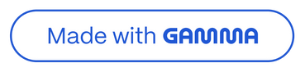
Dashboard Overview
The Power BI dashboard serves as our central hub for performance monitoring, offering a detailed breakdown of key metrics and trends. It provides an interactive platform for exploring sales data.
KPI Summary: Shows the most important numbers like total revenue, number of orders, average order value, and total items sold.
Amazon vs. Merchant Fulfillment: Compares how well Amazon delivery performs versus merchant delivery (speed, orders, and reliability)
Top Cities by Revenue: Shows which cities buy the most and bring the highest sales.
Top Categories by Revenue: Identifies best-selling product lines.
Weekly Sales Trend: Shows how sales change during the week (which days get more orders).
Monthly Revenue Trend: Displays how sales grow or drop month-by-month to understand seasonal patterns.
Filters: Allows you to easily filter data by Month-Year, Category, or Shipping State to see specific insights.
Notes:
4

Slide 5






KPI Cards: Unlocking Strategic Performance Insights
The purpose of our Key Performance Indicator (KPI) cards is to give executives a real-time, data-driven pulse on the state of their company.
Total Revenue : ₹72M +
This is the total money the company earned from all sales. It shows how well the business is performing overall.
Total Orders : 120K+
This tells how many orders customers placed. It helps us understand customer demand and how busy the business is.
Average Order Value (AOV) :₹596
This shows how much money a customer spends on average per order. A higher AOV means customers are buying more items or higher-priced products
Total Quantity Sold : 117K
This is the total number of items sold. It helps us know which products are popular and how much stock the company needs.
Cancellation Rate : 14%
This is the percentage of orders that were cancelled. A high cancellation rate may mean issues with delivery, product information, or customer experience.
Management can track these metrics to quickly identify trends and areas for improvement.
Notes:
5

Slide 6
KPI Metrics and DAX Formulas
1
2
3
Total Revenue
Total Orders
Average Order Value (AOV)
TotalRevenue = SUM(sales_dataset_cleaned[amount])
TotalOrder = DISTINCTCOUNT(sales_dataset_cleaned[order_id])
AOV = DIVIDE([TotalRevenue],[TotalOrder],0)
4
5
Total Quantity Sold
Cancellation Rate
TotalQty = SUM(sales_dataset_cleaned[qty])
CancelRate% = DIVIDE([CancelOrder],[TotalOrder],0)
Notes:
6

Slide 7
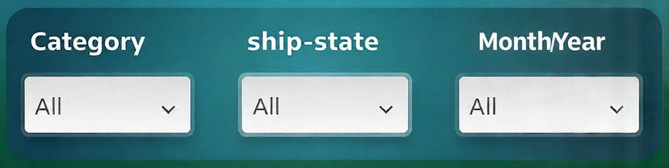
Filters: Month, Category, State
The filters on the dashboard are made to be as flexible as possible, enabling users to perform dynamic analysis that suits their requirements and drill down into particular data categories.
Month-Year Filter
Category-Wise Filter
Helps compare how revenue and orders change month by month.
Allows you to focus on a single product category (e.g., Kurta, Set, Western Dress).
Ship-State Filter
Shows sales data based on different states.
Notes:
7

Slide 8
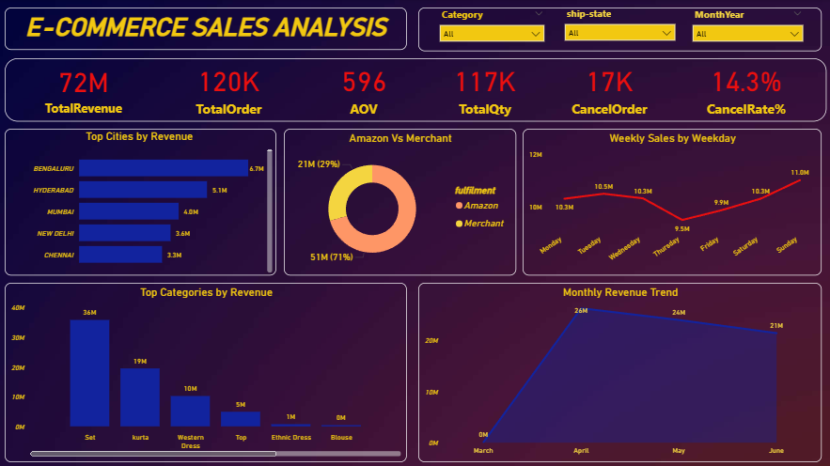
Dashboard
Notes:
8

Slide 9
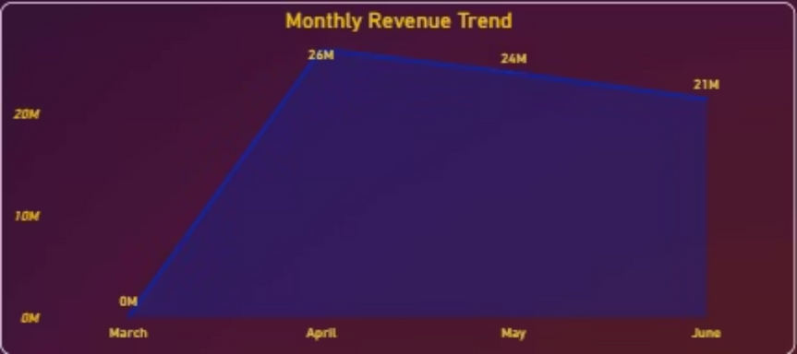
Monthly Revenue Trend
It is simple to observe how sales change from month to month because of to the monthly revenue chart.It is one of the simplest methods to determine whether the business is expanding, staying the same, or slowing down.
Some months show higher revenue, which may be caused by festival seasons, special discounts, or strong customer demand.
Lower-revenue months help us spot slow periods, so the company can improve marketing or promotions.
The trend line makes it easy to notice whether revenue is increasing overall or facing ups and downs.
Trend Highlights Observing growth or decline trends is crucial for identifying areas requiring performance improvement and resource allocation.
Notes:
9

Slide 10
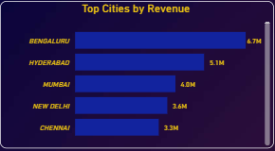
Revenue by City
Understanding city-level revenue distribution is critical for optimizing logistics, marketing spend, and inventory allocation. Focusing on top-performing urban centers maximizes return on investment.
Identifies top revenue-generating cities such as Bengaluru, Hyderabad, and Mumbai.
Shows which locations have high customer demand, helping businesses prioritize marketing and stock supply.
Helps spot low-performing cities, indicating areas where awareness, service, or delivery operations may need improvement.
Notes:
10

Slide 11
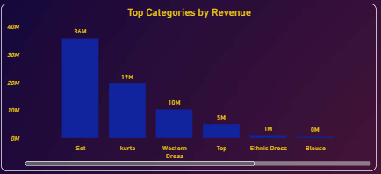
Top Categories by Revenue
Analyzing revenue by product category allows for a strategic approach to inventory management, marketing efforts, and product development, ensuring focus on the most profitable lines.
Shows best-selling categories like "Sets" and "Kurtas" stand out as the highest revenue-generating categories.
Helps identify medium and low-performing categories, useful for inventory and marketing planning
This insight guides decisions to increase inventory for high-demand items and potentially scale back or re-strategize for lower-performing categories.
Notes:
11

Slide 12
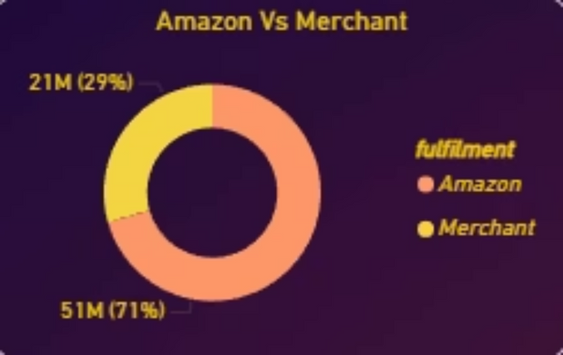
Fulfillment Performance: Amazon vs. Merchant
To compare how orders fulfilled by Amazon perform versus orders fulfilled by the Merchant, in terms of volume, revenue, and delivery speed.
Amazon Fulfillment
Merchant Fulfillment
Handles the majority of orders, indicating its robust infrastructure.
Manages a smaller volume of orders compared to Amazon.
Generally more reliable and efficient, leading to higher customer satisfaction.
May require operational improvements to enhance efficiency and reduce potential delays.
Leverages extensive network for faster delivery and lower cancellation rates.
Focus on streamlining processes to minimize cancellations and improve delivery times.
Notes:
12

Slide 13
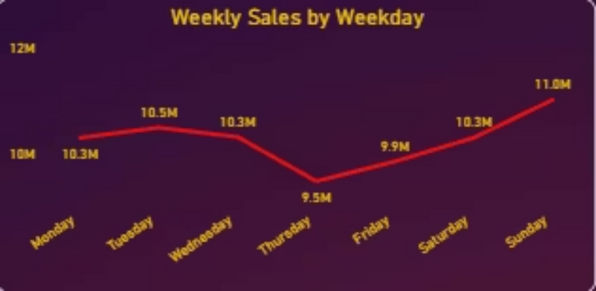
Weekly Sales Trend
Understanding the weekly sales to visualize how revenue changes from Monday to Sunday and understand the weekly buying pattern shown in the dashboard.
The chart highlights the weekdays with the highest revenue, showing when customers are most active and when sales demand is strongest.
These insights help plan workforce scheduling, packaging workloads, and dispatch operations to ensure smooth order fulfillment during busy days.
Days with lower sales provide valuable opportunities for backend work like restocking, inventory checks, and team coordination without affecting customer service.
Notes:
13

Slide 14
Conclusion
Strong sales in metropolitan regions with clear high-demand product categories.
Monthly revenue trends indicate clear seasonal patterns, helping identify high-performing months and periods that need strategic focus.
Fulfillment analysis suggests differences between Amazon and Merchant performance, providing insights for improving delivery efficiency and overall customer experience.
Product demand is driven mainly by categories like Set and Kurta, which consistently generate the highest revenue.
Together, these insights provide a clear and data-driven understanding of sales behavior, customer demand, and operational strengths.
Notes:
14

Slide 15
Recommendations
Focus on high-performing categories like Set and Kurta by maintaining strong inventory and targeted promotions.
Improve merchant fulfillment processes to match the efficiency of Amazon's fulfillment performance.
Prioritize top cities such as Bengaluru, Hyderabad, and Mumbai with better stock planning and localized marketing.
Use slower weekdays for inventory checks and internal operations to support smooth functioning during peak days.
Plan marketing and stock decisions based on monthly revenue patterns to make the most of high-demand periods.
Notes:
15

Slide 16
Thank You
Email - DevangMagare@gmail.com
Linkedin - https://www.linkedin.com/in/devang-magare-7b266b258/
Github - https://github.com/DevangMagare?tab=repositories
Notes:
16

